Slide 1

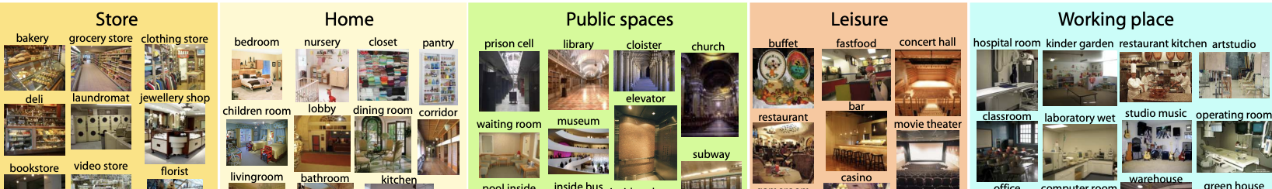
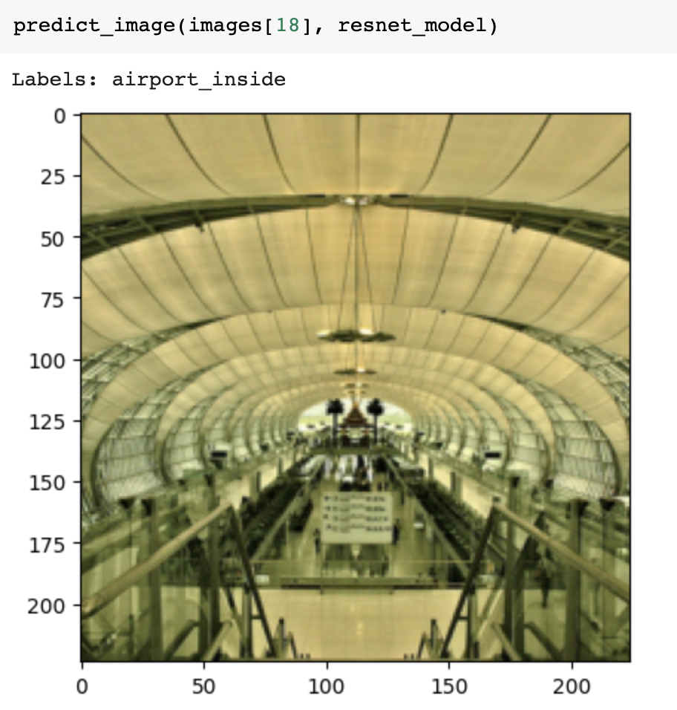
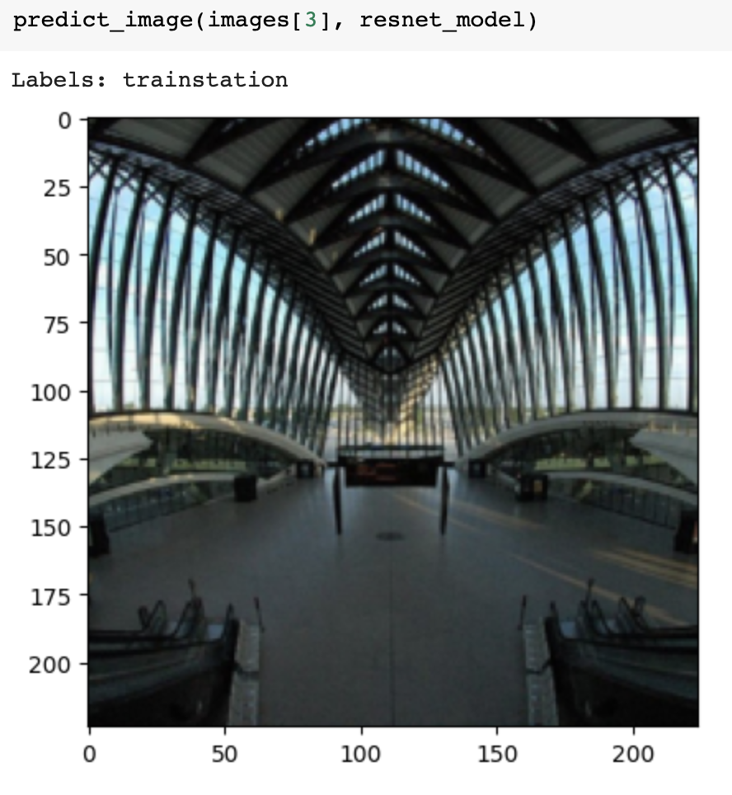
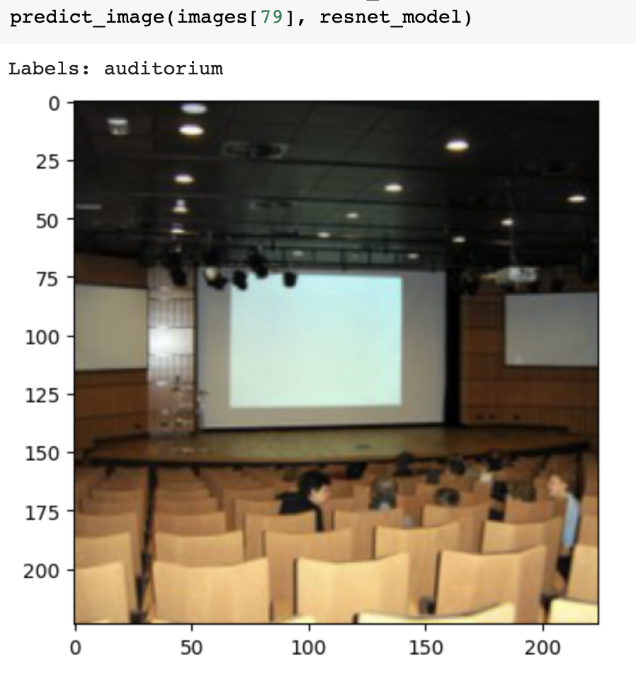
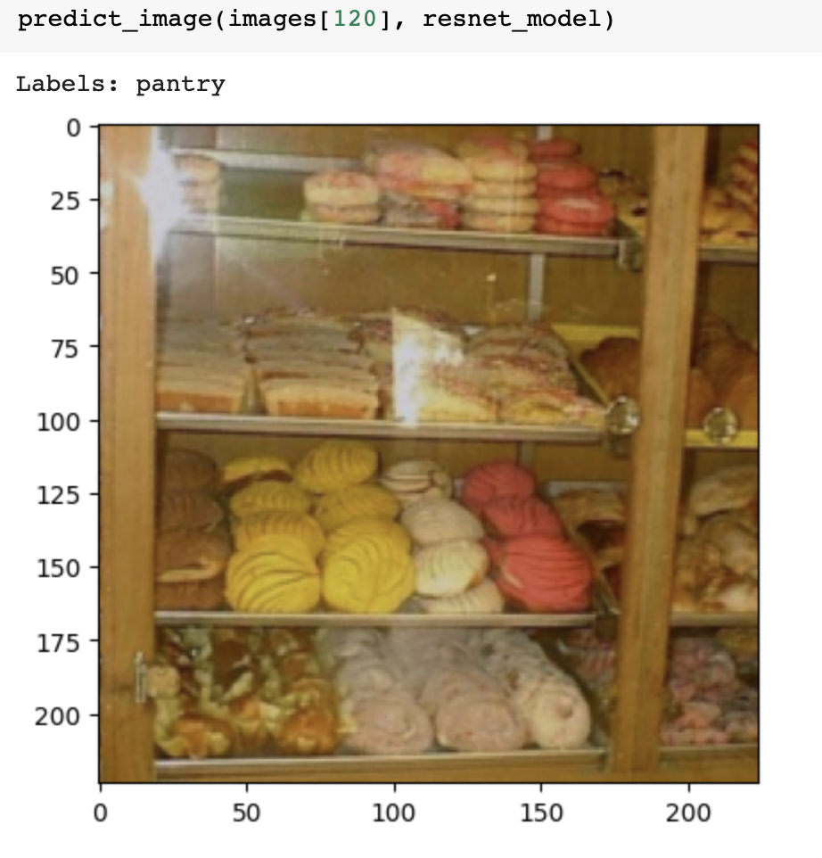
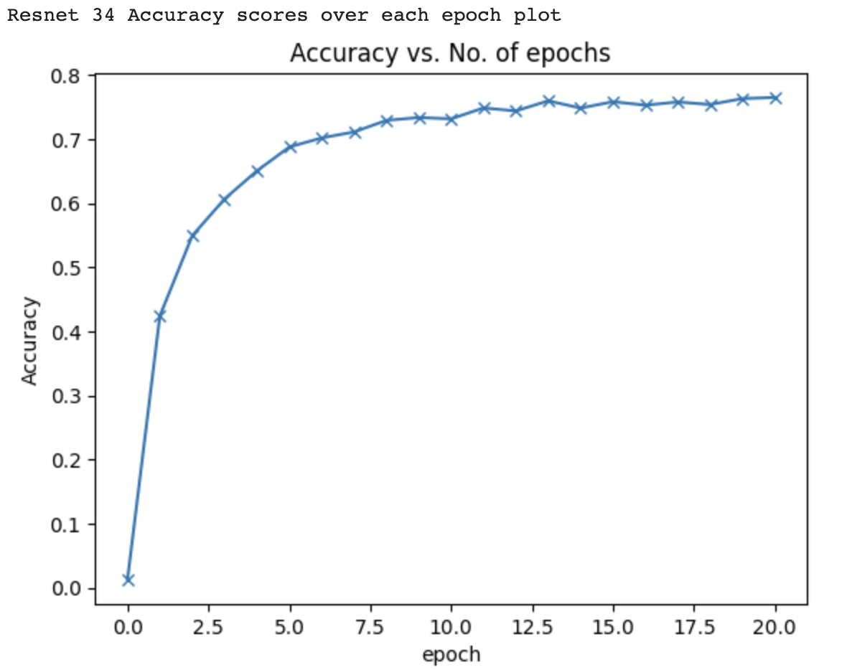
Indoor Scene Recognition
Priyanka Nigade
Mentor: Dr. Christelle Scharff
Pace University, Seidenberg School of CSIS
GitHub - https://bit.ly/3Hp7uIi
Notebook - https://bit.ly/40RrFFU
Abstract
Dataset
Experiments
Image Predictions
Indoor scene recognition is essential for modern applications like Smart Homes and Offices, Robotics, and Virtual Reality as it enables these systems to function efficiently and autonomously. Deep learning can be vital in this scenario because it enables these systems to recognize many objects, and obstacles that are present in indoor scenes. With the help of hyperparameter tuning, I utilized deep learning models like ResNet34, ResNext, GoogleNet, and ShuffleNet to recognize indoor scenes more accurately and with fewer errors.
Dataset URL – https://bit.ly/41Fkh1m
There are 15620 images in all 67 Indoor categories (i.e. Kitchen, Living room, Airport) in the database. A minimum of 100 photos in each category, though the quantity varies between categories. Every image is in the jpg format. The data set is 2.61 GB.
To Avoid avoid biases that may arise from random assignment split-folders package is used to evenly distribute each class of samples across train and test datasets.
Pre-trained weights on large image datasets like ImageNet are used to initialize the models, which are then fine-tuned on the indoor scene dataset.
ReLU activation function is used to avoid the vanishing gradient problem.
Hyperparameters, such as the learning rate and batch size, are tuned to find optimal values for each model.
Related work
Indoor Home Scene Recognition through Instance Segmentation Using a Combination of Neural Networks (2022) is the recent study in this subject and makes use of object recognition and recognizing combinations of objects linked with each scene. A pre-trained Mask-RCNN is used in this case for better object detection.
Convolutional neural networks (CNNs) have been proposed in a variety of configurations, and deep learning models have also been used to classify indoor scenes. A hybrid CNN, for instance, was proposed by Zhang et al. that integrates both global and local aspects of indoor scene situations. To gather multi-scale data from indoor scenes, Li et al. added a spatial pyramid pooling (SPP) layer to the CNN architecture.
Introduction
Result
The primary components of indoor scene classification are accurate and efficient classification of large-scale picture information and correct classification of semantic feature information from related images. Scene recognition in indoor environments can be challenging because the layout, lighting, and contents of indoor environments can differ significantly, or people can capture and label indoor scenes differently. It can be difficult for a deep learning algorithm to recognize and classify indoor scenes accurately because of this.
To tackle these challenges advanced deep learning models are developed and trained employing techniques such as data augmentation, transfer learning, and hyperparameter tuning to improve their accuracy.
After performing data augmentation, I built multiple classifier deep learning models to categorize indoor situations. ResNet34 with 80.24% accuracy, the model performed well. The table for comparing the performance of different models can be seen below.
Model | Accuracy
ResNet34 | 80.24%
GoogleNet | 66.70%
ShuffleNet | 61.36%
Methodology
Created a dataset mapping images and their classes
Two transformation pipelines are utilized using PyTorch's transformations module to standardise input images.
The split-folders package is used to ensure an even distribution of each class across subsets.
Models utilized are: ResNet34, ResNext101_32x16d_wsl, GoogleNet and ShuffleNet.
Model selection is based on complexity, accuracy, and suitability for the available computational resources and dataset size.
Model accuracy is used as a measure of performance.
Conclusions & Future Work
Accuracy of indoor scene recognition can be improved by splitting data evenly for training and testing datasets, using image augmentation and tuning hyperparameters of Deep Learning model. Accuracy of indoor scene recognition is also influenced by the image's quality and labeling.
In future transfer learning using pretrained models can be used and diverse dataset can be created and used by combining different indoor scene databases. Cost can be reduced by developing a model that needs low computational resources.
Research Question
What can be done to build and train a model that can recognize indoor scenes more accurately?

